Slide 1
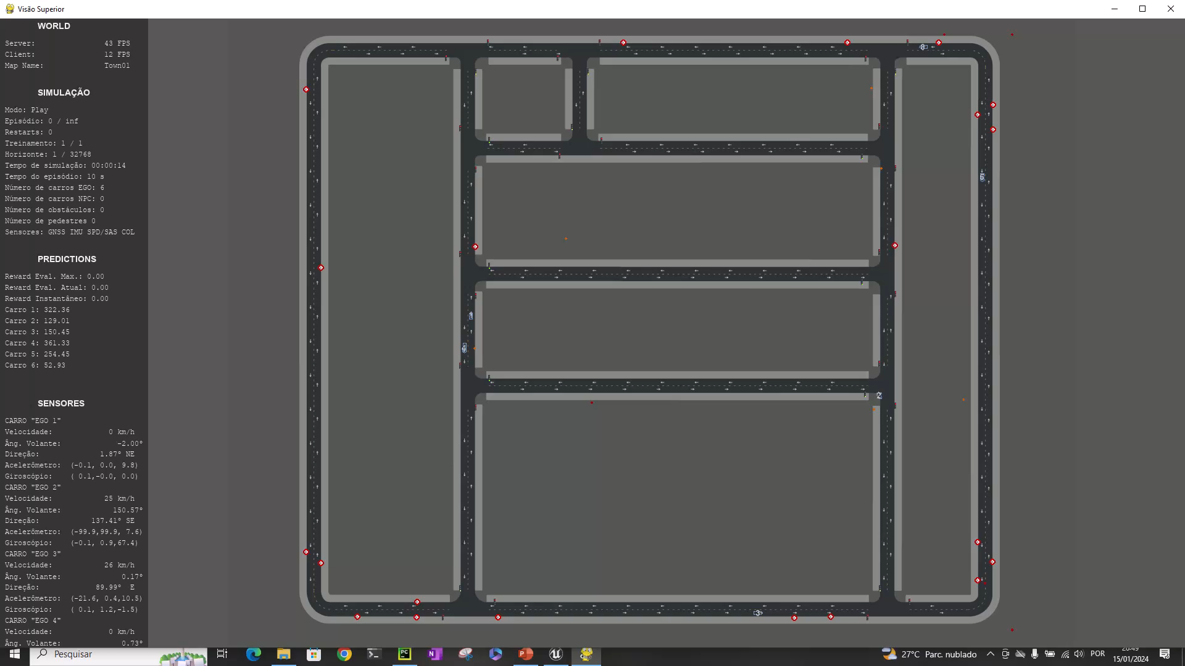
scenario 4 results
Multi-agent Localization
DRL vs EKF Comparison

